Slide 1
Overview
Landing Page 1
Hyperlink - Consumers
Download app
Hyperlink - Businesses
IOT Business
Industry
Brands
Hyperlink - Token
Stake
Mine
Products
Documentation
Company
Liquidity pools
Team
Roadmap
Investors
Homepage Section 2 - Opportunity - MarketPlace with some animation
Homepage Section 3 - Multi-coin mining Network Infrastructure
Homepage Section 4 - Micro Financing for Micro Real Estate
Homepage Section 5 – Product Stack
Homepage Section 6 - Value Proposition of consumer
Homepage Section 7 - value Proposition for Real estate Owners
Homepage Section 8 – Partner with us
Footer

Slide 2

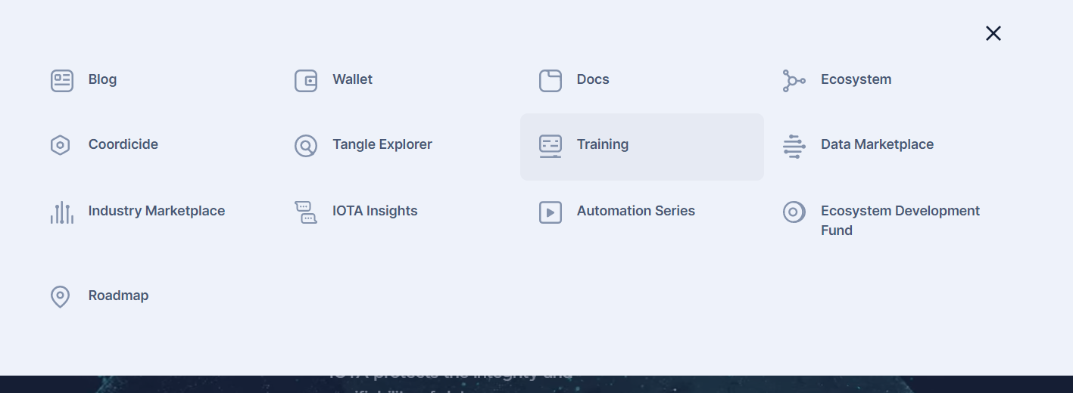
Drop Down
consumers
Businesses
token
Products
Documentation
About us
Home/ Logo
World's largest IoT private communication network with micro real estate assets
Get started
Lite paper
Animation/ Graphic
Drop Down(iota.org)

Slide 3
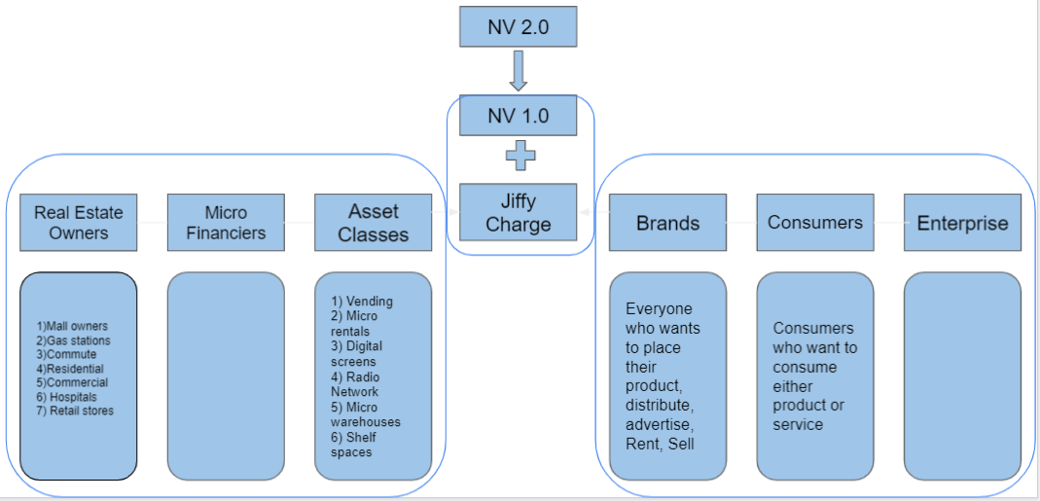

Landing page- Section 2 - Market Place
Market place
Description

Slide 4
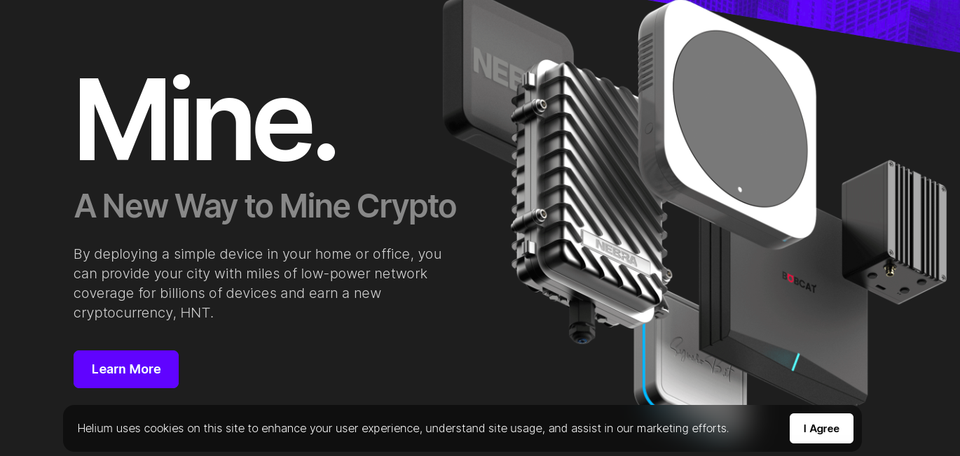
Landing page- section 3 – Multicoin Mining
Mine
Multi coin network infrastructure
Ncash economics
Reference for page design and content

Slide 5
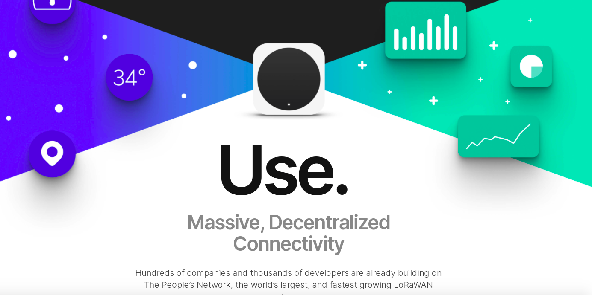
Landing page- section 4 – Micro Finance
De-Fi Platform
Micro real estate assets
Description

Slide 6
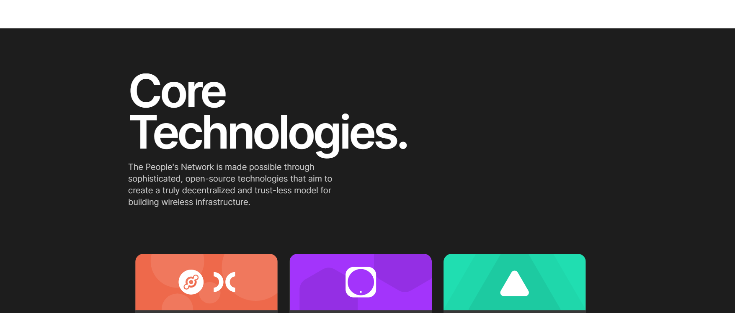
Landing page- section 5– Product Stack
NV 2.0 private network
IoT assets layer
De- Fi lending
Micro real estate marketplace
Private blockchain

Slide 7
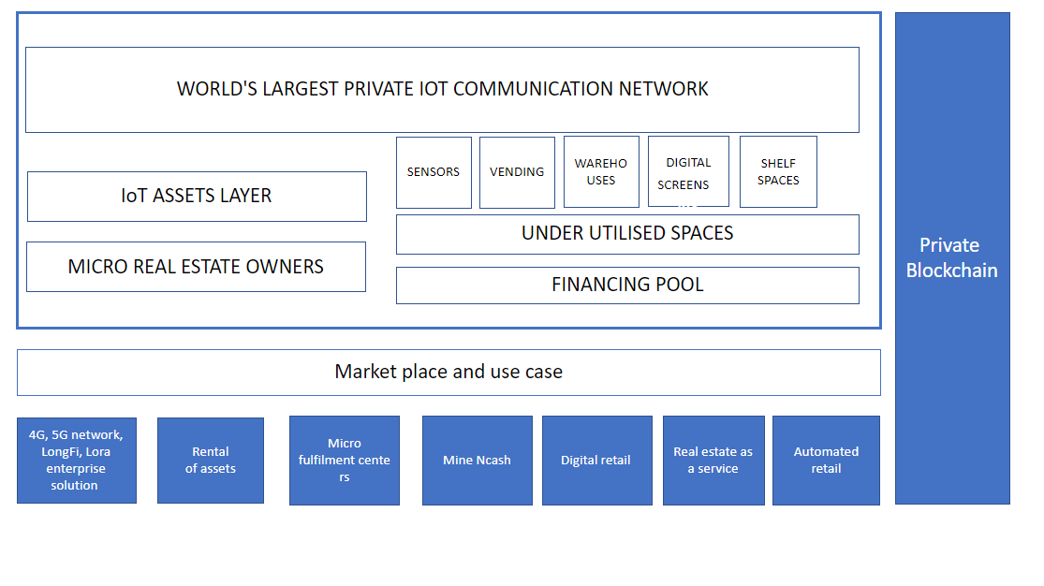
Landing page- section 6 – Value Proposition for Consumer
Overview

Slide 8
Landing page- section 7 – Value Proposition For Business Owner
Overview
Use Cases
Micro retail
Micro warehousing
Fulfilment centers
Storage centers
Automated retail
Digital OOH
Micro rentals
Power bank sharing
Pop stores
MRE marketplace
Radio network
Smart Storage lockers

Slide 9

Landing page- section 8
Interested to partner with us?
Start by telling us who you are and we will reach out to you at the earliest
Brand
Real estate owner
miner
vendor
Other?
Media agency
Our Partners

Slide 10

Footer
Get Instant Updates to your Inbox!!
Enter you Email
Join Mailing List
Hyperlinks
Home
Support
Careers
Documentation
About Us
NCash Links
Mining
Stake
Social Media Links
Contact Us
With Emails
LOGO
Terms and Conditions
Privacy Policy
NCash Policy
Press

Slide 11
Consumer Section 1

